Slide 1
Project on Power BI

Slide 2
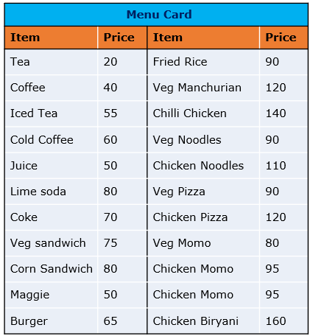
Problem Statement
We have the sales data of a restaurant of the last 15 days. It consists of details on the time of customer visit, type of orders, the amount spent against the orders by the customers, etc.
The restaurant provides a variety of menus.
However, the management wants to take action on cost-cutting and improving the profit.
Analyze the data and help them by providing actionable insights with the visual representation of data analysis to justify your suggestions.

Slide 3
Part-1
Task 1

Slide 4
Task One
Item-wise order quantity Which Items have been ordered most and which items have been ordered least? What will be your conclusion based on this?
Find out for which item more units are ordered in a single order. Do we observe more units ordered against lower-priced items or higher-priced items?
Visually present the following in a single view: The percentage of sales amount generated for each item in different types of orders; we should be able to filter the order type The total quantity ordered for each item in different order types; we should be able to filter the items ordered Identify the 3 top selling items and 3 least selling items in each order type in terms of quantity Identify 3 items that are contributing higher to the sale amount and the 3 items that are contributing much less to the sales amount
Find out: Which are the items being ordered by customers in at least 3 meal types? Which are the items being ordered in more than one meal type? What insights do we get from this? Should we discontinue any of these items, and why?

Slide 5
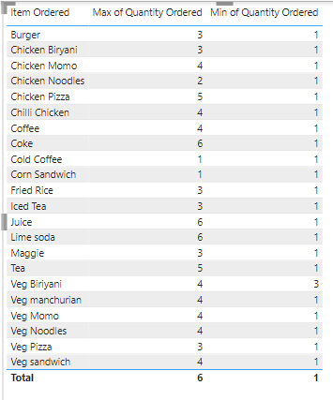
Item-wise order quantity
Which Items have been ordered most and which items have been ordered least?
What will be your conclusion based on this?
Conclusion:
Lime soda and Juice are the most popular items with the highest maximum order quantities.
Several items, including Burger, Chicken Momo, and many others, have been ordered minimally, indicating they might not be as popular.

Slide 6
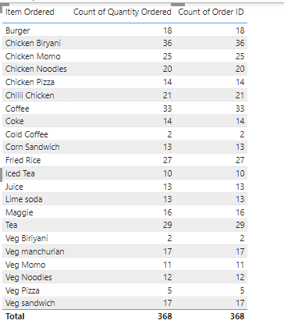
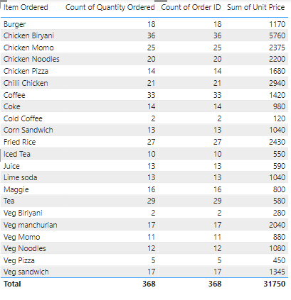
Find out for which item more units are ordered in a single order. Do we observe more units ordered against lower-priced items or higher-priced items?
more units are ordered for lower-priced items.
Here's why:
We can see that items like Burger, Chicken Momo, and Chicken Noodles, which likely have lower prices compared to items like Chicken Biryani or Chilli Chicken, have higher "Count of Quantity Ordered" values.
This suggests that customers tend to order more units of the less expensive items.

Slide 7
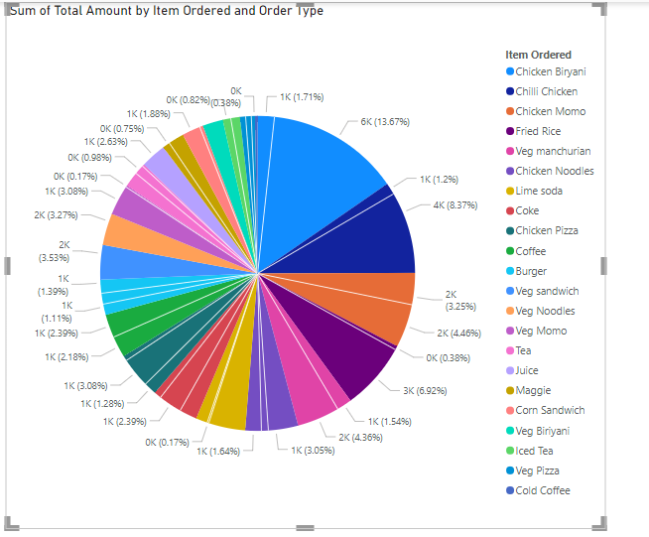
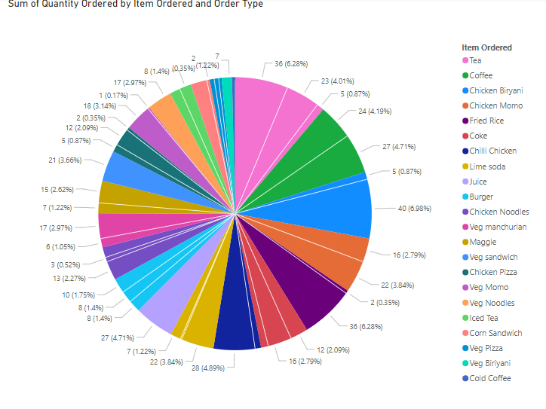
Visually present the following in a single view: The percentage of sales amount generated for each item in different types of orders; we should be able to filter the order type The total quantity ordered for each item in different order types; we should be able to filter the items ordered Identify the 3 top selling items and 3 least selling items in each order type in terms of quantity Identify 3 items that are contributing higher to the sale amount and the 3 items that are contributing much less to the sales amount

Slide 8
Top 3 Items Contributing to Sales: Tea: With a significantly higher quantity ordered compared to other items, Tea appears to be a top contributor to sales. Lime Soda: It has a consistently high quantity ordered across different order types, making it a strong contributor. Lunch: While not a specific item, the Lunch category as a whole has high order quantities across multiple items, suggesting it contributes substantially to sales. Bottom 3 Items Contributing to Sales: Veg Biryani: This item has minimal quantities ordered across all order types, indicating a lower contribution to sales. Cold Coffee: Similar to Veg Biryani, Cold Coffee has a relatively low quantity ordered. Corn Sandwich: This item also shows a lower quantity ordered compared to other items.

Slide 9
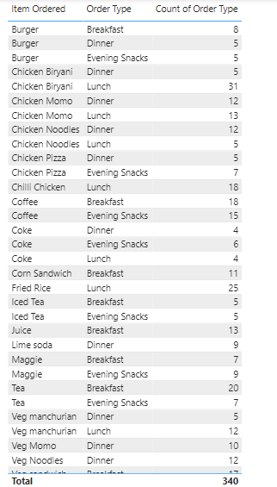
Find out: Which are the items being ordered by customers in at least 3 meal types? Which are the items being ordered in more than one meal type? What insights do we get from this? Should we discontinue any of these items, and why?
Items ordered in at least 3 meal types:
Burger
Coffee
Items ordered in more than one meal type:
Burger
Chicken Biryani
Chicken Momo
Chicken Noodles
Chicken Pizza
Coke
Maggie
Tea
Veg Manchurian
Insights and potential discontinuation:
High frequency items: Burger and Coffee are ordered in all three meal types, indicating strong demand.
Versatile items: Chicken Momo, Chicken Noodles, Chicken Pizza, and Veg Manchurian are popular across multiple meal types, suggesting their versatility.
Limited appeal: Some items like Coke, Maggie, and Tea, while ordered in multiple meal types, might have lower order counts compared to others, warranting further analysis of their profitability.
Potential discontinuation: Items like Veg Manchurian and Chicken Biryani, with lower order counts across meal types, could be potential candidates for discontinuation if their profitability is low or they occupy valuable inventory space. However, further analysis of factors like profit margins, customer feedback, and overall menu balance is necessary before making a decision.

Slide 10

TEAM-4
Sneha Singh
Leader
Nikita Vishwakarma
Member
Nipun Parashar
Member
Saurabh Singh
Member
Siddhant Tandon
Member
Arindam Mukherjee
Member

Slide 11

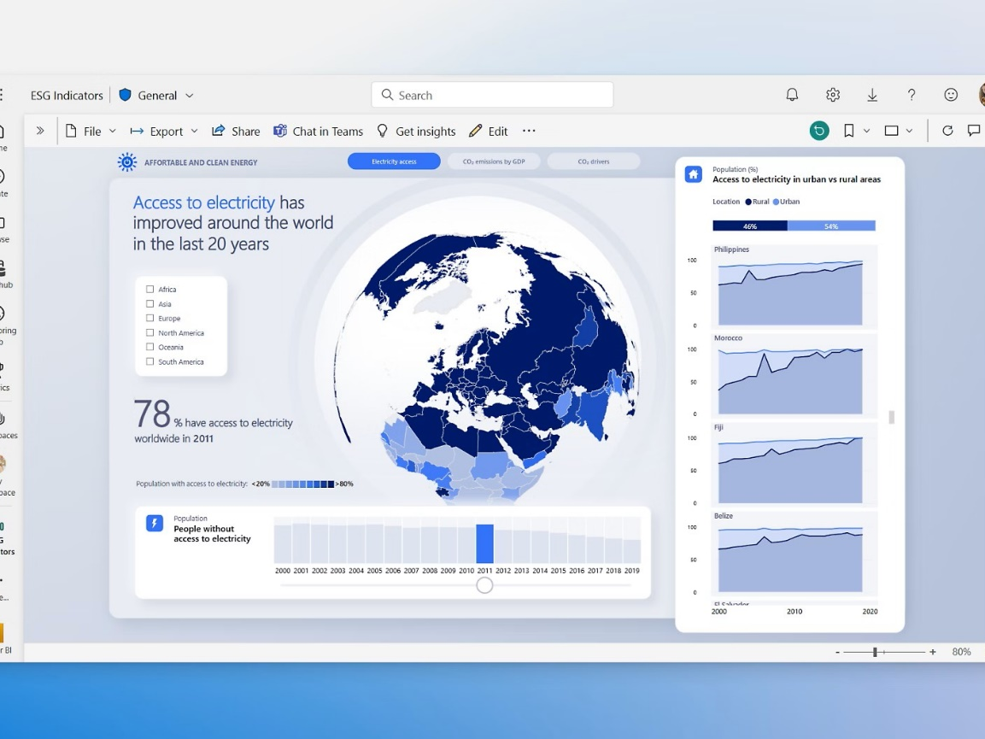
Summary of Power BI
Power BI is a business intelligence (BI) tool developed by Microsoft. It's designed to transform raw data into visually appealing and interactive insights. Think of it as a powerful tool that helps you understand your data better and make informed decisions.
Key Components
Power BI Desktop: Where you create and design your reports and dashboards.
Power BI Service: A cloud-based service for sharing and collaborating on reports.
Power BI Mobile Apps: Access your reports and dashboards on the go.
Core Functionalities
Data Connection: Connects to various data sources like Excel, SQL Server, and cloud-based platforms.
Data Modeling: Structures and transforms data for analysis.
Data Visualization: Creates interactive charts, graphs, and maps to represent data.
Report Creation: Combines visualizations into comprehensive reports.
Dashboard Design: Builds interactive dashboards for easy data consumption.
Sharing and Collaboration: Shares reports and dashboards with others.
Benefits
Data-Driven Decisions: Uncovers trends, patterns, and insights.
Improved Efficiency: Automates reporting and analysis tasks.
Enhanced Collaboration: Facilitates data sharing and teamwork.
Visual Storytelling: Effectively communicates insights through visualizations.

Slide 12
Thank you

